Slide 1
Lecture 2: Computer Logic
To watch lecture video click link below
Lecture 2 video
To view slides, continue to next slide

Slide 2
Lecture 2: Computer Logic
Appendix B.1 – B.3

Slide 3
Introduction
This lecture provides a brief discussion of the basics of logic design
Logic circuits are the fundamental units of computer hardware
Topics covered
Gates and Truth Tables
Logic Equations
Constructing combinational logic circuits

Slide 4
Truth Table
Signals: asserted or de-asserted
Asserted: simply called logically true or 1
De-asserted: simply called logically false or 0
Truth table
Defines the values of outputs for each possible set of input values
as seen in CS1300 Discrete Structures
2 inputs => 4 rows
3 inputs => 8 rows

Slide 5
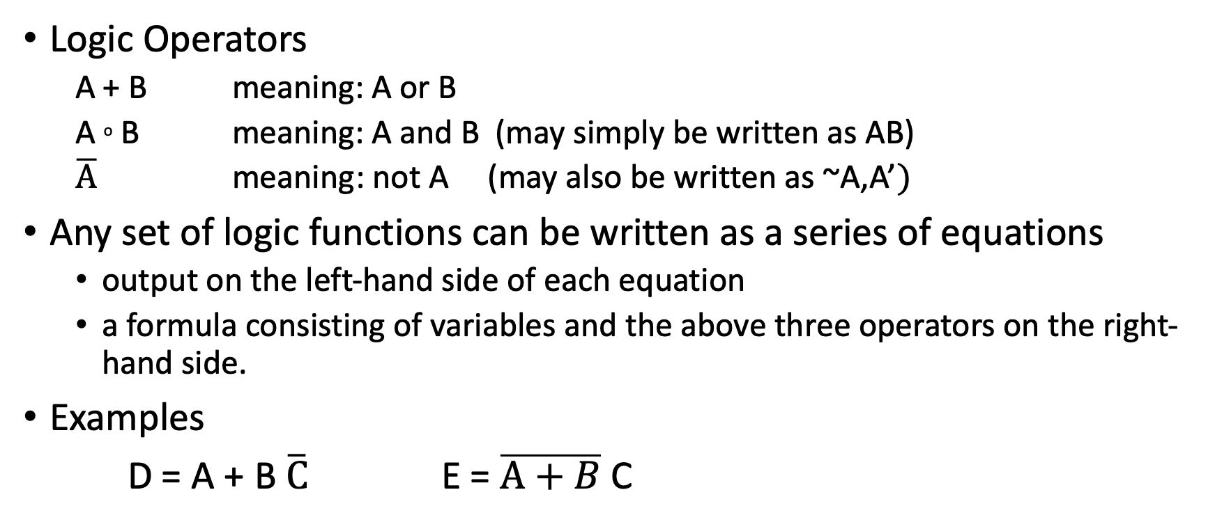
Logic Equations
Logic Operators
A + B meaning: A or B
A º B meaning: A and B (may simply be written as AB)
$\overline{A}$ meaning: not A (may also be written as ~A,A’$)$
Any set of logic functions can be written as a series of equations
output on the left-hand side of each equation
a formula consisting of variables and the above three operators on the right-hand side.
Examples
D = A + B $\overline{C}$ E = $\overline{A+B}$ C

Slide 6
Boolean Algebra
Boolean operations follows precedence and associativity rules similar to arithmetic operations, e.g.
Precedence: not (highest), and (next), or (lowest)
Also follows a number of algebraic laws, e.g.
Identity laws A + 0 = A A º 1 = A
Commutative law: A + B = B + A A º B = B º A
…
(details omitted, please review related topics in CS1300 Discrete Structures )

Slide 7
Gates
Logic blocks are built from gates that implement basic logic functions
e.g. an AND gate implements the AND function, and an OR gate implements the OR function.
NOR and NAND gates
NOR: Inverted OR Gate
NAND: Inverted AND Gate
XOR gate
Exclusive OR gate
Gate Drawings

Slide 8
Gates and Truth Tables
Note: symbols may vary

Slide 9
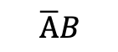
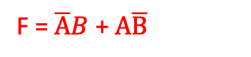
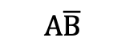
Building Combinational Logic Circuits
From Truth Table to Logic Equation
Example 1:
Inputs A and B; output F
Step 2: Write out minimum terms from each row
Step 3: Write out maximum terms for F
Step 1: Find rows where F is 1
A | B | F
0 | 0 | 1
0 | 1 | 0
1 | 0 | 1
1 | 1 | 0
A | B | F
0 | 0 | 0
0 | 1 | 1
1 | 0 | 1
1 | 1 | 0
F = $\overline{A}B$ + $A\overline{B}$
$$\overline{A}B$$
$$A\overline{B}$$
Note: if you’re not familiar with minimum and maximum terms, just ignore these terminology here.

Slide 10
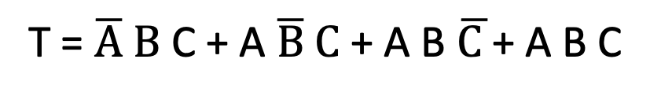
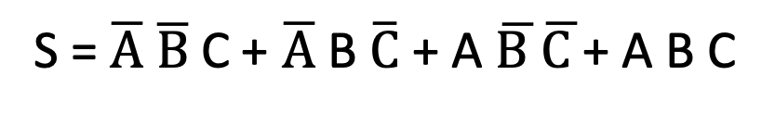
From truth table to logic equation
Example 2:
Input A, B, C; Output: S, T
A | B | C | S | T
0 | 0 | 0 | 0 | 0
0 | 0 | 1 | 1 | 0
0 | 1 | 0 | 1 | 0
0 | 1 | 1 | 0 | 1
1 | 0 | 0 | 1 | 0
1 | 0 | 1 | 0 | 1
1 | 1 | 0 | 0 | 1
1 | 1 | 1 | 1 | 1
S = $\overline{A} \overline{B}$C + $\overline{A}$B $\overline{C}$+ A $\overline{B }\overline{C }$+ A B C
T = $\overline{A} B$ C + A $\overline{B} C$+ A B $\overline{C }$+ A B C
Note: In this class, we will not cover optimization. So just leave the equation unoptimized.

Slide 11
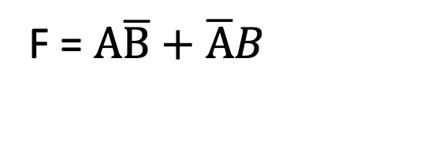
From logic equation to circuit diagram
F = $A\overline{B}+\overline{A}B$

Slide 12
Programming Logic Array (PLA)
Provides a simple solution to building logic circuit

Slide 13
Decoder
A binary decoder takes n inputs and generates 2^{n} outputs. (e.g. 3 inputs, 8 outputs.)
Each output has a unique bit of 1, the rest all 0s.

Slide 14
Multiplexor (Mux)
Example: a 2-bit multiplexor where s is the selector.
A | B | S | C
0 | 0 | 0 | 0
0 | 0 | 1 | 0
0 | 1 | 0 | 0
0 | 1 | 1 | 1
1 | 0 | 0 | 1
1 | 0 | 1 | 0
1 | 1 | 0 | 1
1 | 1 | 1 | 1
S | C
0 | A
1 | B
when S = 0, C is the same as A; S = 1, C is B.
This is the 2-input Mux symbol we will use in this class.
Complete truth table

Slide 15
Summary
Brief introduction to logic design and circuits
Youtube videos are available for more details
General understanding of computer logic is needed for this class
However, we will not get into details in this class as we will use block diagrams and description of functionalities to represent hardware units
Study zyBook Appendix B 8.1 – 8.3
Homework H1

